Slide 1
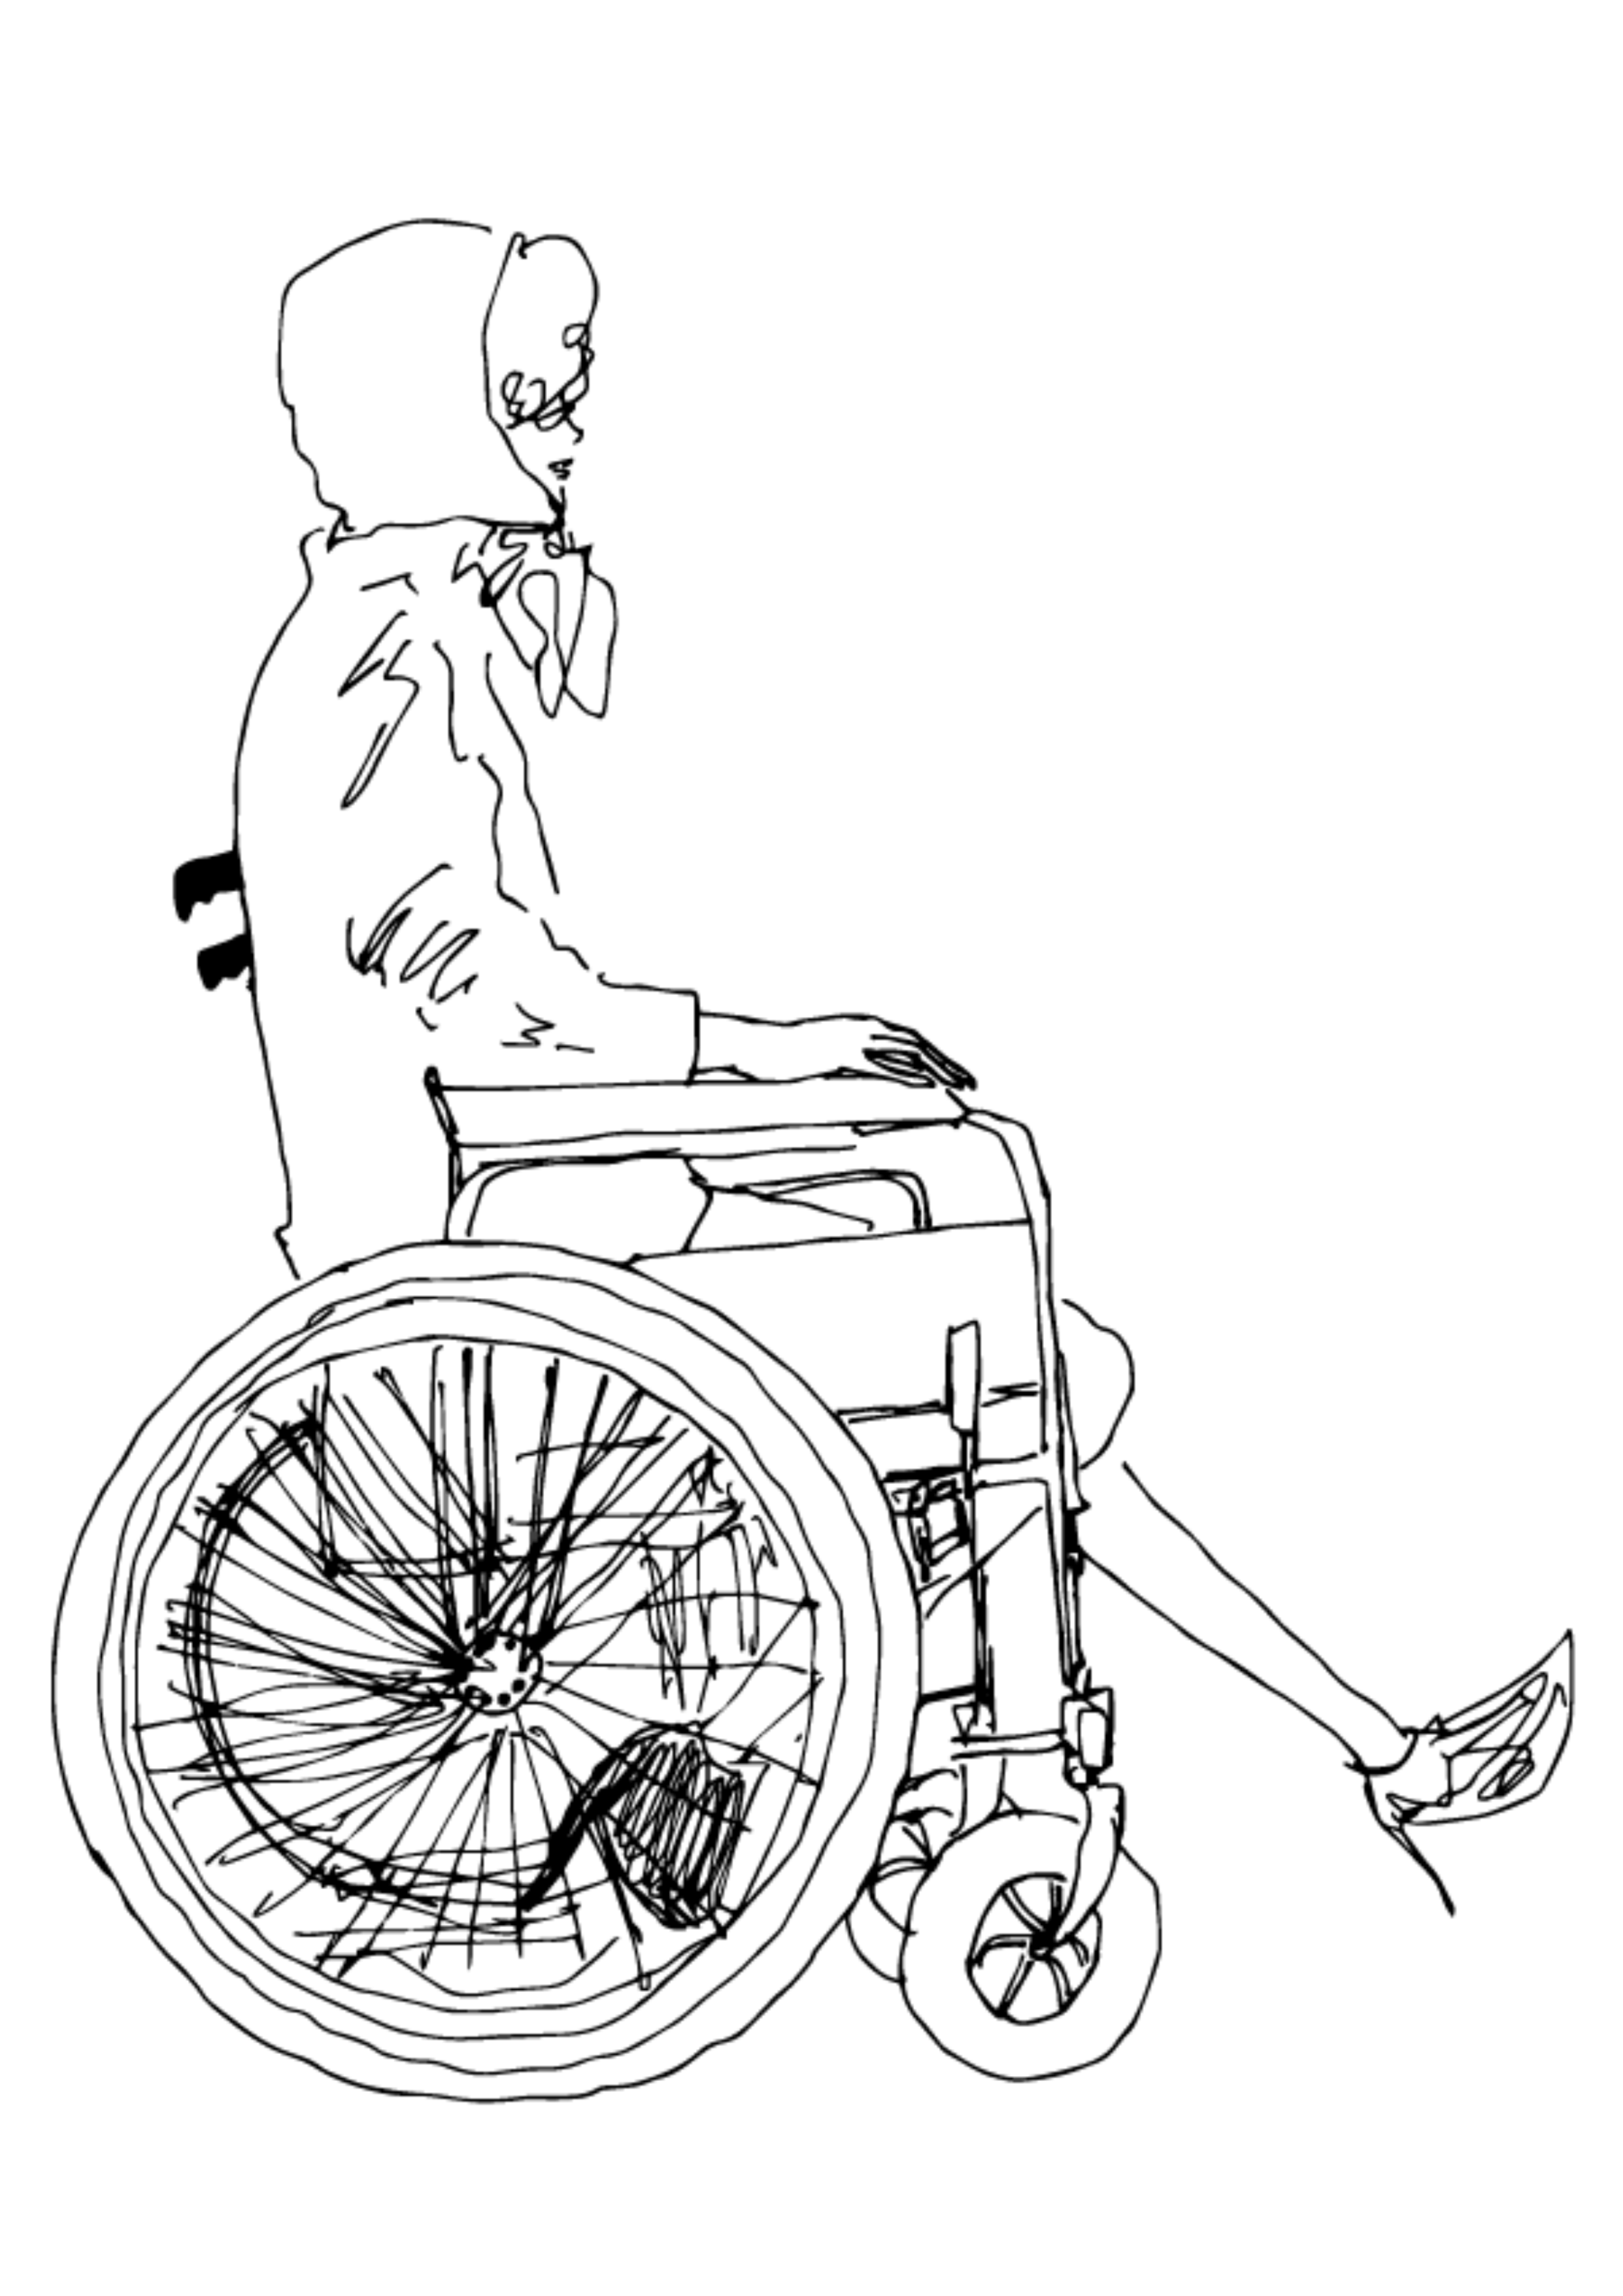
Japan
Adaptive
Fashion

Slide 2
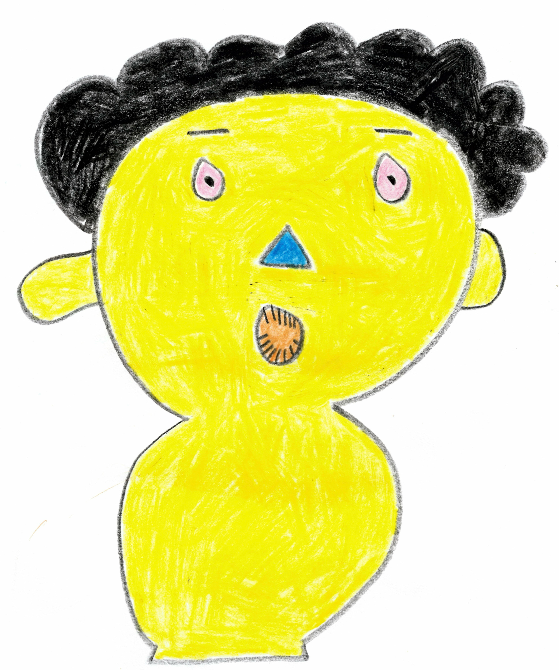
OBACHAN
OBACHAN
OBACHAN
OBACHAN
OBACHAN
OBACHAN
OBACHAN
OBACHAN
OBACHAN

Slide 3
